Slide 1


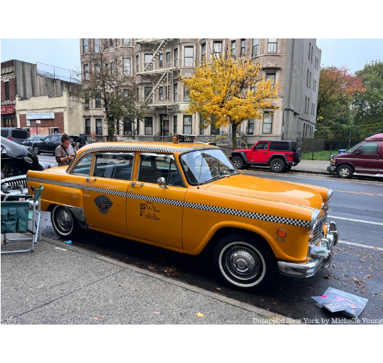


MAXIMIZING REVENUE FOR DRIVERS
Optimizing Fare Pricing & Trip Distances via Payment Method Analysis
DATASET CONTEXT
NYC Taxi and Limousine Commission (TLC) Trip Records
Maximizing Revenue for Taxi Drivers
Slide 1 / 11

Slide 2

Agenda
•
Problem Statement
•
Analysis and Findings
•
Research Question
•
Hypothesis Testing
•
Data Overview
•
Recommendations
•
Methodology
Executive Project Agenda
Slide 2 / 11

Slide 3




Problem Statement
In the fast-paced taxi booking sector, making the most of revenue is essential for long-term success and driver happiness.
Our goal is to use data-driven insights to maximise revenue streams for taxi drivers in order to meet this need.
Our research aims to determine whether payment methods have an impact on fare pricing by focusing on the relationship between payment type and fare amount.
Commercial Problem Statement
Slide 3 / 11

Slide 4




Research Question
Is there a relationship between total fare amount and payment type?
Can we nudge customers towards payment methods that generate higher revenue for drivers, without negatively impacting customer experience?
+18.9%
+22.0%
82.9%
OBSERVED CARD FARE PREMIUM
LONGER TRANSIT DISTANCE
CURRENT DIGITAL ADOPTION
Core Analytical Inquiries
Slide 4 / 11

Slide 5

Data Overview
For this analysis, we utilized the comprehensive dataset of NYC Taxi Trip records, used data cleaning and feature engineering procedures to concentrate solely on the relevant columns essential for our investigation.
passenger_count | trip_distance | payment_type | fare_amount | duration
1 | 7.51 mi | Cash | $35.90 | 27.82 min
1 | 6.14 mi | Card | $27.50 | 22.70 min
1 | 2.40 mi | Card | $19.10 | 19.95 min
2 | 0.86 mi | Card | $7.20 | 5.30 min
1 | 5.89 mi | Card | $28.90 | 25.33 min
Relevant columns used for this research:
•
passenger_count (1 to 6)
•
payment_type (Card or Cash)
•
fare_amount (base fare $)
•
trip_distance (miles)
•
duration (minutes)
Feature Engineering & Data Overview
Slide 5 / 11

Slide 6
Methodology
Step | Description
Data Cleaning & Hygiene | Derived trip duration; resolved 955K missing values (proved 100% Flex Fares); pruned deduplicated rows; removed non-positive values and capped outliers via 1.5×IQR boundary trimming.
Descriptive Analysis | Performed statistical analysis to summarize key aspects of the data, focusing on fare amounts, transit distance, and payment types across groups.
Confounder Analysis | Cross-tabulated passenger volume against payment channels to prove group capacity does not bias the fare differences between Card and Cash.
Hypothesis Testing | Conducted Welch's Two-Sample Independent T-test to evaluate the relationship between payment type and fare amount, statistically testing if differences are significant.
End-to-End Analytical Methodology
Slide 6 / 11

Slide 7



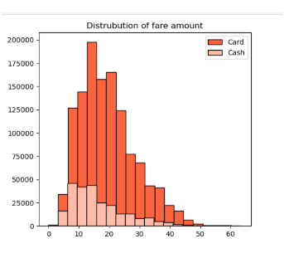
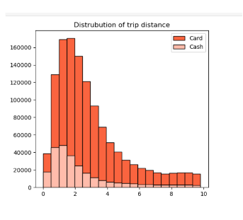
Journey Insights
•
Customers paying with cards tend to have a slightly higher average trip distance and fare amount compared to those paying with cash.
•
Indicates that customers prefer to pay more with cards when they have high fare amount and long trip distance.
Metric | Payment Type | Mean | Standard Deviation
Fare amount | Card | $19.44 | $9.20
Cash | $16.35 | $9.11
Trip distance | Card | 2.94 mi | 2.16 mi
Cash | 2.41 mi | 2.14 mi
Fare Amount Distribution
Trip Distance Distribution
Comparative Fare & Distance Distributions
Slide 7 / 11

Slide 8


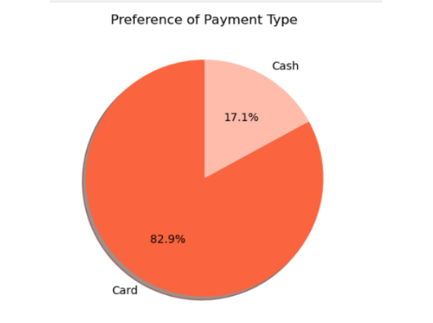



Preference of Payment Types
The proportion of customers paying with cards is significantly higher than those paying with cash, with card payments accounting for 82.9% of all transactions compared to cash payments at 17.1%.
This indicates a strong preference among customers for using card payments over cash, potentially due to convenience, security, or corporate expense habits.
+$3.09 per ride
DRIVER REVENUE LIFT ON CARD TRANSACTIONS (+18.9%)
Market Share & Channel Preference Breakdown
Slide 8 / 11

Slide 9


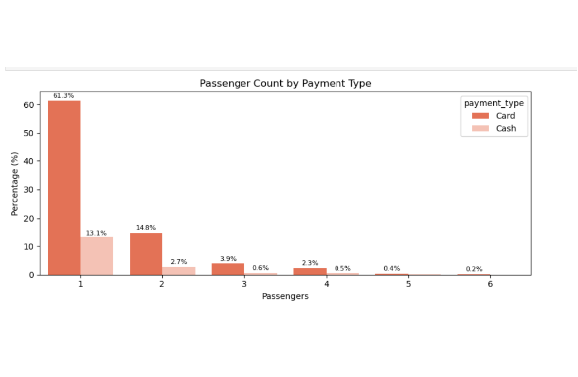
Passenger Count Analysis
•
Among card payments, rides with a single passenger (passenger_count = 1) comprise the largest proportion, constituting 61.3% of all card transactions (and 13.1% for cash).
•
Similarly, two-passenger rides represent 14.8% Card vs. 2.7% Cash, while larger groups (3 to 6) decrease rapidly.
•
There is a noticeable decrease in the percentage of transactions as passenger count increases, with 5 and 6 passenger trips accounting for under 1% of total volume.
•
Key Confounder Takeaway: Payment preference ratios remain fixed (~5:1) across all party sizes, confirming party size does not bias fare differences.
Confounder Analysis on Passenger Groups
Slide 9 / 11

Slide 10


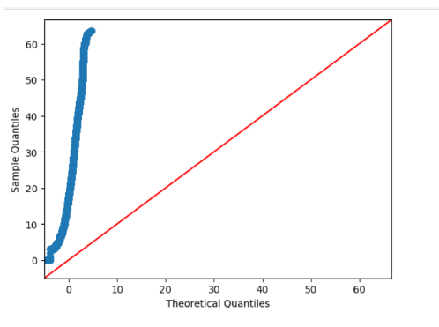


Hypothesis Testing
Null hypothesis ( ): There is no difference in average fare between customers who use credit cards and customers who use cash.
Alternative hypothesis ( ): There is a difference in average fare between customers who use credit cards and customers who use cash.
Welch's Two-Sample T-Test Output
T-STATISTIC
OBSERVED P-VALUE
t = 155.24
p = 0.0000
With a T-statistic of 155.24 and a P-value far below 0.05, we decisively reject the null hypothesis. There is indeed a statistically significant difference in average fare between payment channels.
Q-Q Plot: CLT ensures mean normality ( )
Statistical A/B Hypothesis Proof
Slide 10 / 11

Slide 11



Recommendations
Encourage customers to pay with credit cards to capitalize on the potential for generating more revenue for taxi cab drivers.
Implement strategies such as offering incentives or discounts for credit card transactions to incentivize customers to choose this payment method.
Provide seamless and secure credit card payment options to enhance customer convenience and encourage adoption of this preferred payment method.
Strategic Business Takeaways
Slide 11 / 11

Slide 12


Image Sources
https://storage.ghost.io/c/3e/3b/3e3b259f-e5a2-4287-97e8-4888d22daaef/content/images/wp-content/uploads/2022/10/marvelous-mrs-maisel-filming-locations-horn-and-hardart-set-amazon-studios-crown-heights-brooklyn-nyc14.jpg
Source: www.untappedcities.com
https://images.stockcake.com/public/a/d/6/ad6548c1-6114-462c-8769-404c126151fa_large/golden-success-arrow-stockcake.jpg
Source: stockcake.com

